Slide 1
SAP BTP Extension Suite Training
Day 23
Anubhav Oberoy
www.AnubhavTrainings.com
Follow excellence with sheer passion

Slide 2


DISCLAIMER
The training content and delivery of this presentation is confidential, and cannot be recorded, or copied and distributed to any third party, without the written consent of Anubhav Trainings

Slide 3
Agenda – Day 23
01
Reusable Types and Generics
02
Getting started CAPM ts development
03
Using OData V4 from S/4HANA

Slide 4

TypeScript Configuration – tsconfig.json
The tsconfig.json file is the heart of every TypeScript project.
It tells the TypeScript compiler how to process your code, which files to include, and which features to enable or disable.
A well-configured tsconfig.json ensures a smooth developer experience and reliable builds.
compilerOptions: Controls how TypeScript compiles your code (e.g., target, module, strictness).
include: Files or folders to include in the compilation.
exclude: Files or folders to exclude.
files: Explicit list of files to include (rarely used with include).
extends: Inherit options from another config file.
references: Enable project references for monorepos or multi-package setups.
Use command tsc --init generate the tsconfig.json file
7
www.anubhavtrainings.com
7

Slide 5
Why Use TypeScript with Node.js?
TypeScript brings static typing to Node.js development, providing better tooling, improved code quality, and enhanced developer experience.
Key benefits include:
Type safety for JavaScript code
Better IDE support with autocompletion
Early error detection during development
Improved code maintainability and documentation
Easier refactoring
mkdir my-ts-node-app cd my-ts-node-app npm init -y npm install typescript @types/node --save-dev npx tsc –init
7
www.anubhavtrainings.com
7

Slide 6
Utility types
Utility types are built-in generic types that transform existing types into new ones — no need to rewrite interfaces from scratch.
They're like type factories—you feed in a type, and out comes a new type with different properties.
Think of it like this: if you have a blueprint for a house, utility types let you create variations—a blueprint with fewer rooms, optional walls, readonly doors, etc.—without rewriting everything from scratch.
7
www.anubhavtrainings.com
7

Slide 7
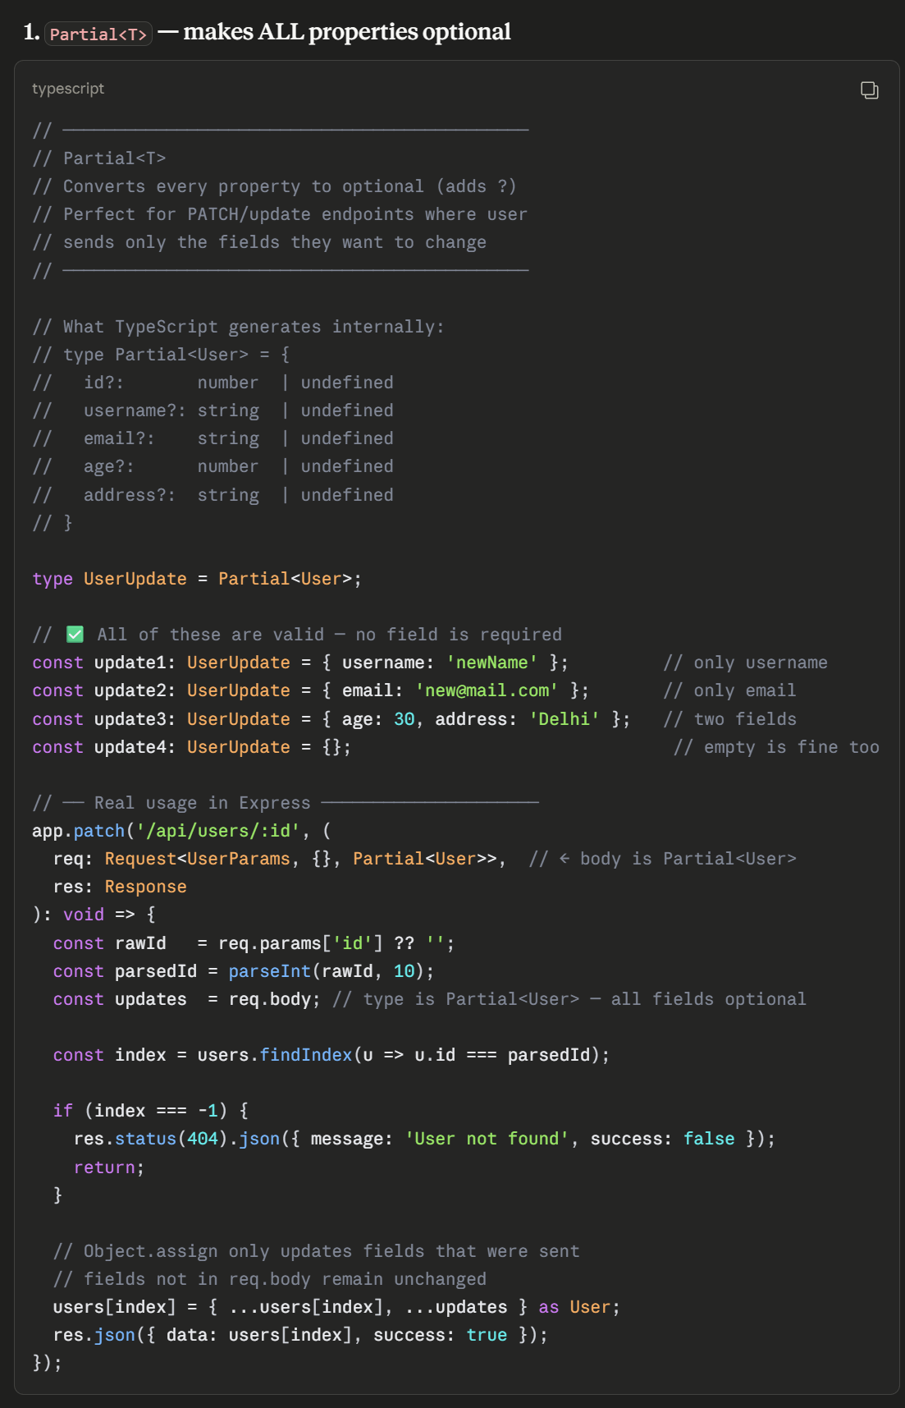
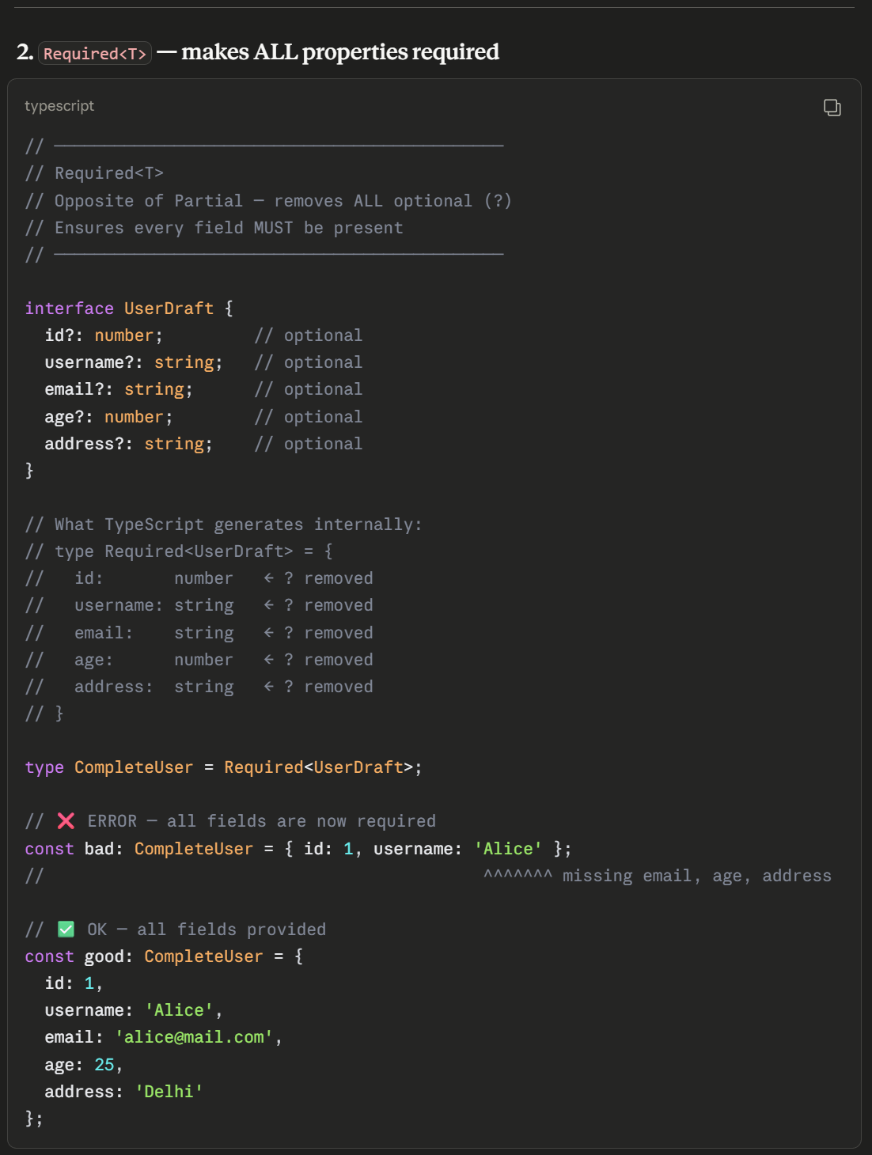
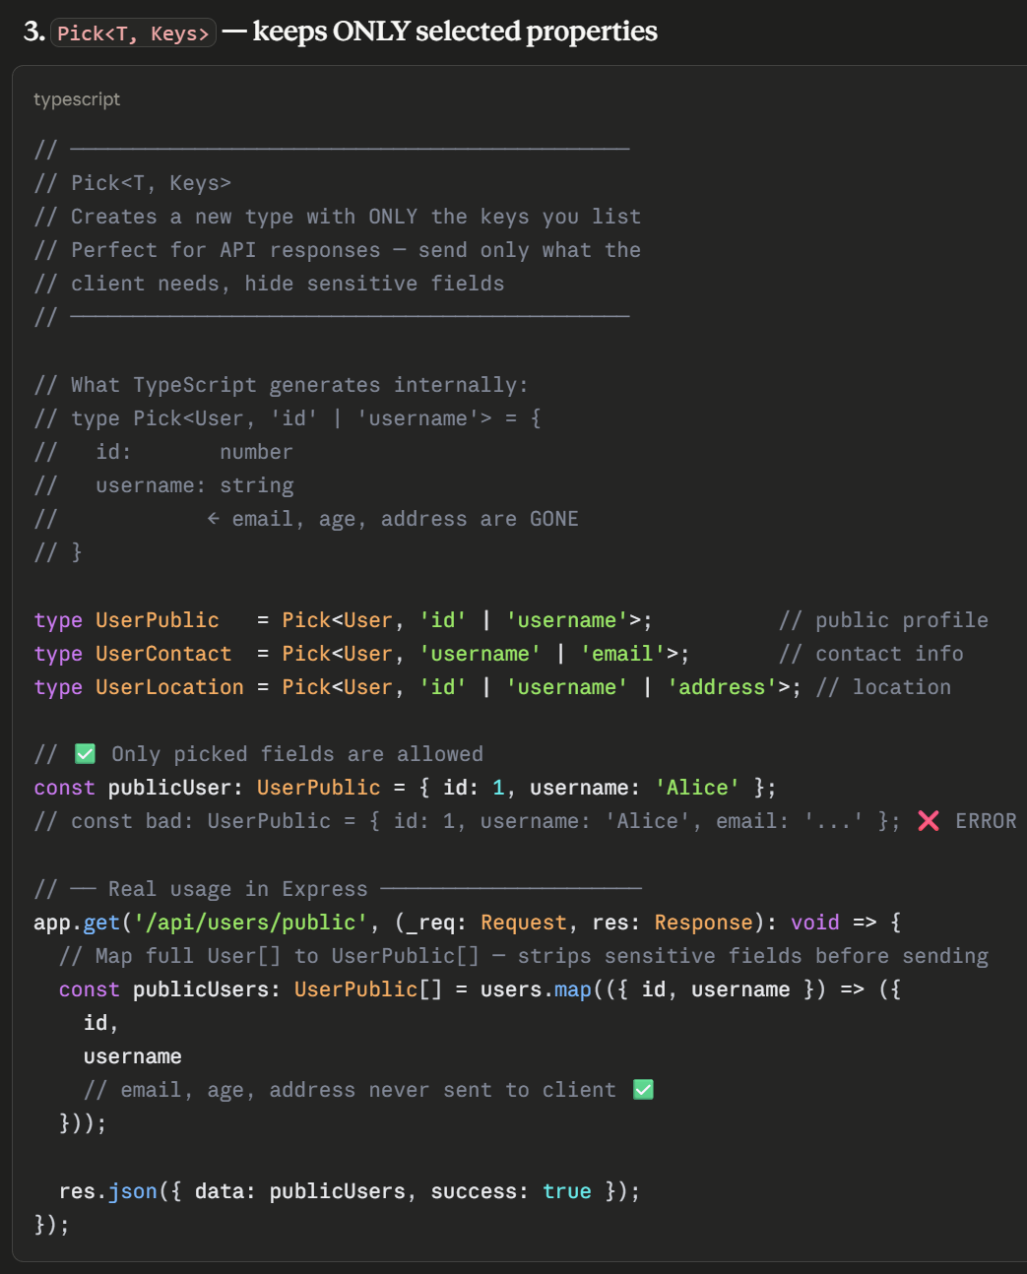
Partial, Required, Pick
Text
7
www.anubhavtrainings.com
7

Slide 8
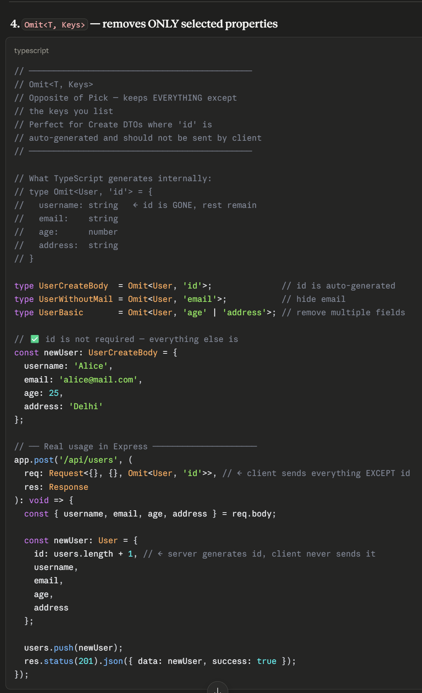
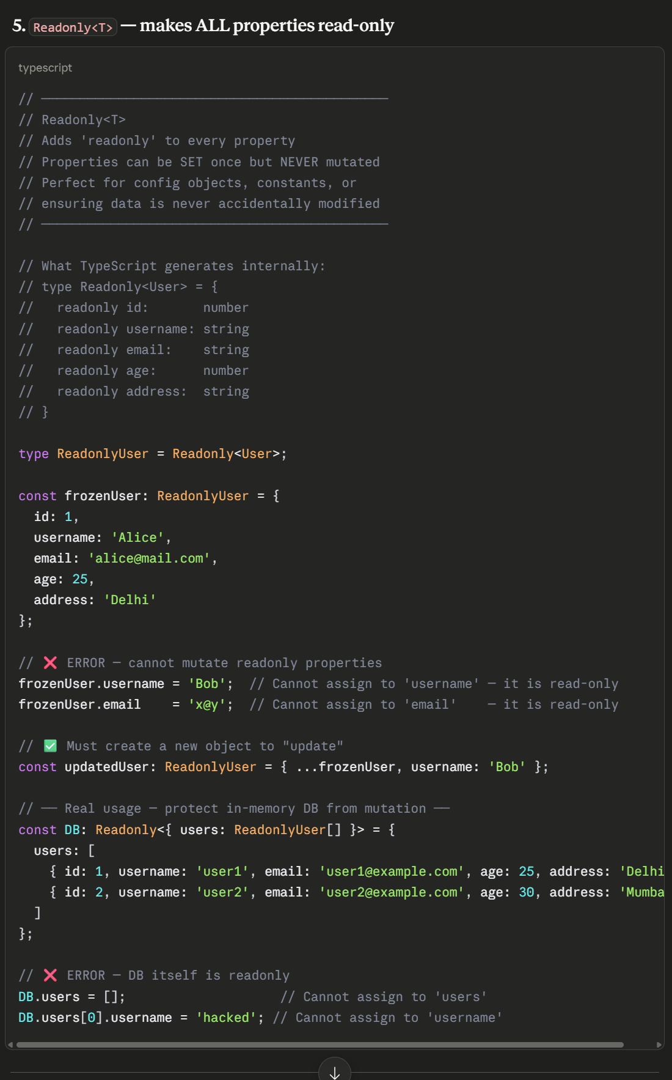
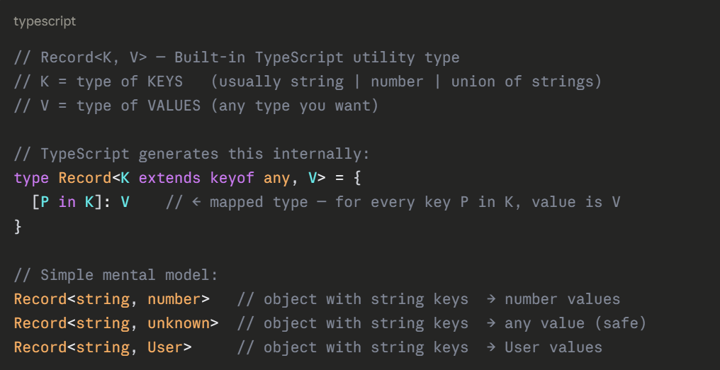
Omit and ReadOnly
7
www.anubhavtrainings.com
7

Slide 9
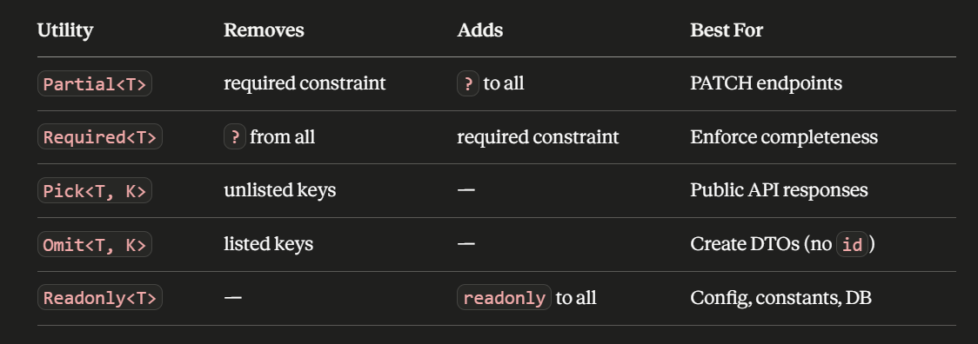
Summary
7
www.anubhavtrainings.com
7

Slide 10
SAP BTP CAP + TypeScript
End-to-End Integration with S/4HANA
Step 1: Scaffold • Step 2: Generate • Step 3: Consume • Step 4: Test

Slide 11
The Business Use Case
💡 A 'mashup' service = local data + remote data in one API
Part A — Local Domain Model (Step 1)
✓ Material & Plant entities stored in local database
✓ Three business rules / validations
✓ Seed data (10 plants, 20 materials)
Part B — Remote S/4HANA Integration (Steps 2–4)
✓ Live Sales Order OData service (V4)
✓ Fully typed, generated client code
✓ GET (read) and POST (create) operations

Slide 12
The Four Phases
Phase 1 — SCAFFOLD
Create TypeScript CAP project, wire tooling, verify local + cloud
Phase 2 — GENERATE
Use Cloud SDK to generate typed client from S/4HANA EDMX
Phase 3 — IMPLEMENT
Write typed mashup handler with reusable parsers & type guards
Phase 4 — TEST
Connect to live system via BTP Destination, end-to-end verified

Slide 13
Why TypeScript for CAP?
✓ Catch typos at edit-time, not at 3AM in production
req.data.materilName → red underline instantly
✓ API contracts verified at compile-time
Field names, types, required vs. optional — all checked
✓ Two automatic type sources (zero hand-written interfaces)
1. cds-typer generates from .cds model
2. Cloud SDK generator from remote EDMX
✓ Remote API changes are caught instantly

Slide 14
File Architecture
srv/CatalogService.ts — the orchestrator
Registers handlers, wires helpers, stays thin
srv/lib/config-loader.ts — connection settings
Reads .env / BTP Destination, validates connectivity
srv/lib/payload-parser.ts — the bouncer
Untrusted JSON → typed SalesOrderInput, rejects bad input
srv/types/sales-order.d.ts — shared vocabulary
SalesOrderInput, SalesOrderView, S4Config — all agree
srv/src/generated/… — typed S/4HANA client (auto-generated)

Slide 15
Step 1 — Scaffold TypeScript CAP
Create project skeleton, wire tooling, prove local + cloud work

Slide 16
What We Build in Step 1
Two database entities with validation rules:
Material
materialName, materialType, baseUnit, plant (association)
Plant
plantName, storageLocation, country, city
Three handlers in CatalogService.ts:
1. Before CREATE Material → name = 40 chars, no digit start
2. Before UPDATE Material → referenced Plant must exist
3. Before CREATE Plant → max 2 plants per storage location

Slide 17
Scaffold the Project
Install CAP developer kit globally:
npm install -g @sap/cds-dk
cds --version
Create project with TypeScript enabled:
cds init capm-s4-mashup --add typescript
cd capm-s4-mashup
Or add TypeScript to existing project:
cds add typescript
This automatically installs typescript, @cap-js/cds-types, ts-node

Slide 18
Project Structure
capm-s4-mashup/
├── app/ # UI (empty for now)
├── db/ # data model (.cds)
│ └── schema.cds # Material + Plant entities
├── srv/ # services & handlers
│ ├── catalog-service.cds
│ └── CatalogService.ts # The three handlers
├── package.json
├── tsconfig.json # TypeScript compiler config
└── .gitignore

Slide 19
Key tsconfig.json Options
target: "ES2022" — Node 18+ supports latest JS natively
module: "NodeNext" — Supports both CommonJS & ES Modules
strict: true — noImplicitAny, strictNullChecks enabled
noEmit: true — tsc type-checks only; cds watch produces .js
paths: { "@sap/cds" → "@cap-js/cds-types" }
Redirect cds imports to richer type definitions
allowJs: false — Forces all files to be .ts (after migration)

Slide 20
Define the Data Model
namespace capm.s4.mashup;
entity Plant : cuid {
plantName: String;
storageLocation: String;
country: String;
city: String;
}
entity Material : cuid {
materialName: String;
materialType: String;
baseUnit: String;
plant: Association to Plant;
}

Slide 21
CatalogService.ts Structure
import cds from '@sap/cds';
import type { Material, Plant } from '#cds-models/capm/s4/mashup';
export default class CatalogService extends cds.ApplicationService {
async init() {
// Register three handlers:
this.before('CREATE', 'Materials', req => this.beforeCreateMaterial(req));
this.before('UPDATE', 'Materials', req => this.beforeUpdateMaterial(req));
this.before('CREATE', 'Plants', req => this.beforeCreatePlant(req));
return super.init();
}
}

Slide 22
Handler 1 — Material Validation
private async beforeCreateMaterial(req: cds.Request) {
const { data } = req;
const { materialName } = data as Material;
if (!materialName || materialName.length !== 40) {
return req.reject(400, 'Material name must be 40 chars');
}
if (/^\d/.test(materialName)) {
return req.reject(400, 'Cannot start with digit');
}
}

Slide 23
Handler 2 & 3
Handler 2 — Plant Reference Check
Verify referenced Plant ID exists before UPDATE
Handler 3 — Storage Location Limit
Enforce max 2 plants per storage location on CREATE
Pattern for all three:
1. Extract typed data from request
2. Validate business rule
3. req.reject(status, message) if invalid
4. Handler completes normally if valid

Slide 24
Run Locally & Verify
Start the dev server:
cds watch
You should see:
✓ 10 plants loaded from CSV
✓ 20 materials loaded from CSV
✓ CatalogService initialized
✓ API listening on http://localhost:4004
Test with curl:
curl http://localhost:4004/odata/v4/catalog/Plants

Slide 25
Type Check & Deploy
Type check before deploy:
npx tsc --noEmit
Build for Cloud Foundry:
npm run build
Login & deploy:
cf login -a <api-endpoint>
cf push
Verify in the cloud:
cf logs capm-s4-mashup --recent

Slide 26
Step 2 — Generate S/4HANA SDK
Turn EDMX metadata into fully typed client code

Slide 27
Key Concepts
EDMX = Extensible Metadata Description (OData V4 schema)
S/4HANA publishes EDMX at:
http://122.162.240.164:8010/sap/opu/odata4/$metadata
Cloud SDK generator reads EDMX and creates:
✓ Request builders (type-safe API calls)
✓ Entity interfaces (request/response shapes)
✓ All in TypeScript with full autocompletion
Goal: Zero hand-written interfaces for the remote API

Slide 28
Install & Generate
npm install -D @sap-cloud-sdk/generator
npm install @sap-cloud-sdk/odata-v4
Download EDMX metadata:
curl -u <user>:<pass> http://122.162.240.164:8010/...
> srv/external/s4-edmx.xml
Run generator:
npx generate-odata-client \
--input srv/external \
--outputDir srv/src/generated
Result: ~1,000+ lines of fully typed client code

Slide 29
Generated Code
sales-order-api.ts exports:
SalesOrderApi with typed methods
requestBuilder(), getAll(), getByKey(), create(), update()
sales-order.ts exports:
SalesOrder entity interface (fully typed)
SalesOrderItem nested interface
Request/response payloads automatically derived
Every field is:
✓ Typed (string, number, Date, etc.)
✓ Nullable checked (? for optional fields)
✓ With JSDoc comments from EDMX

Slide 30
Step 3 — Implement Service Consumption
Write typed, reusable mashup handlers

Slide 31
Three Layers
Layer 1 — config-loader.ts
Reads .env / BTP, validates credentials
Manages SDK config (url, username, password)
Layer 2 — payload-parser.ts
Validates incoming JSON → typed SalesOrderInput
Clear error messages for bad input
Layer 3 — CatalogService.ts handlers
Calls sdk.getAll() / sdk.create() with typed data
Handles errors gracefully
Connected by shared types in sales-order.d.ts

Slide 32
config-loader.ts
export interface S4Config {
url: string;
username: string;
password: string;
}
export function loadConfig(): S4Config {
const config: S4Config = {
url: process.env.S4_URL || '',
username: process.env.S4_USER || '',
password: process.env.S4_PASS || '',
};
if (!config.url || !config.username) {
throw new Error('Missing S4 credentials');
}
return config;
}

Slide 33
payload-parser.ts
export interface SalesOrderInput {
salesOrderType: string;
soldToParty: string;
material: string;
requestedQuantity: number;
}
export function parseSalesOrder(raw: any): SalesOrderInput {
if (!raw.salesOrderType) {
throw { status: 400, message: 'salesOrderType required' };
}
return { /* validated & typed */ } as SalesOrderInput;
}

Slide 34
CatalogService Handler
import { salesOrderService } from './generated';
import { loadConfig } from './lib/config-loader';
import { parseSalesOrder } from './lib/payload-parser';
async getSalesOrders() {
const config = loadConfig();
const orders = await salesOrderService()
.salesOrderApi.requestBuilder()
.getAll().top(50)
.execute(config);
return orders;
}

Slide 35
Step 4 — Test BTP Destination
Connect locally to live S/4HANA through cloud bindings

Slide 36
Destination Concept
Problem: Hard-coding URLs + passwords is risky
Solution: BTP Destination service
✓ Centralized place to store URL, credentials, auth type
✓ Named reference (e.g., 'S4HANA_SALESORDER')
✓ No secrets in code or .env
For local testing (hybrid mode):
✓ Cloud bindings come live from BTP
✓ Code runs on your laptop
✓ Realistic environment before deployment

Slide 37
Create Destination in BTP
Navigate to:
Subaccount → Connectivity → Destinations
New Destination:
Name: S4HANA_SALESORDER
Type: HTTP
URL: http://122.162.240.164:8010
Auth: BasicAuthentication
User: <S4_USER>
Password: <S4_PASSWORD>
Additional Properties:
sap-client=100

Slide 38
Bind & Configure
Create service instance:
cf create-service destination lite s4-destination
Create service key:
cf create-service-key s4-destination s4-key
Bind to local project:
cds bind -2 s4-destination
Configure package.json:
Add hybrid profile with destination config
"[hybrid]": { "credentials":
{ "destination": "S4HANA_SALESORDER" } }

Slide 39
Test with .http File
@host = http://localhost:4004
### GET sales orders
GET {{host}}/odata/v4/catalog/getSalesOrders()
Accept: application/json
### POST sales order
POST {{host}}/odata/v4/catalog/createSalesOrder
Content-Type: application/json
Expected Results:
GET: 200 + array of orders
POST: 201 + created order number

Slide 40
Run in Hybrid Mode
Start with hybrid profile:
cds watch --profile hybrid
You should see:
✓ Destination S4HANA_SALESORDER connected
✓ Local Materials/Plants still served
✓ CAP listening on http://localhost:4004
Now open srv/tester.http in VS Code
Install REST Client extension (if not already)
Click 'Send Request' above GET/POST

Slide 41
Journey Complete! 🎉
One TypeScript CAP app with local & remote data, deployed to BTP, tested live

Slide 42
What You Built
✓ Fully typed TypeScript CAP project
✓ Local Material & Plant entities with validations
✓ Generated S/4HANA client (no hand-written interfaces)
✓ Typed GET/POST mashup handlers
✓ Reusable config-loader & payload-parser
✓ Type guards & error handling
✓ Deployed to Cloud Foundry
✓ Hybrid testing with BTP Destination
✓ Live end-to-end verified on real S/4HANA

Slide 43
Patterns to Reuse
1. Scaffold with cds init --add typescript
Works for ANY CAP project
2. Generate SDK from EDMX
Works for any SAP service (SCP, Analytics, Procurement)
3. Separate config-loader & payload-parser
One job per file — easy to test & reuse
4. Hybrid testing with Destinations
Cloud-realistic without deploying
5. tsc --noEmit before every deploy
Catch bugs at compile-time

Slide 44
Next Steps
Extend the mashup:
✓ Add UPDATE/DELETE handlers
✓ Implement CSRF token handling
✓ Batch request support
Scale TypeScript patterns:
✓ Multiple remote systems
✓ Advanced generics
✓ Decorators for cross-cutting concerns
Deploy with confidence:
✓ Automated tests with Jest
✓ CI/CD pipeline to BTP

Slide 45
SAP BTP Fiori JavaScript → TypeScript
Incremental Migration Guide
of SAPUI5 Freestyle Applications

Slide 46
The Use Case — manageorder App
manageorder is a freestyle (hand-written) SAPUI5 application
What it does:
• View1 — List of sales orders (fetch from OData service)
• View2 — Detail view with value-help popups
• View3 — Supplier detail
• Add — Create form for new orders
• BaseController — Shared parent with formatter
• util/formatter.js — Status/type code converters

Slide 47
Current Structure → Target Structure
TODAY (All JavaScript):
✗ No type-checking
✗ Typos only blow up at runtime (in production!)
✗ No IDE autocomplete on OData shapes
AFTER ALL STEPS (Full TypeScript):
✓ Every .js → .ts (except 3rd-party libs)
✓ types/datatype.d.ts holds shared shapes
✓ Type gate: tsc --noEmit passes
✓ App Router for BTP deployment

Slide 48
The Four Phases
Step 1 — PREPARATION
Install ui5-tooling-transpile, typescript, types
Wire ui5.yaml, add tsconfig.json
Convert ONE controller to prove hybrid setup
Step 2 — CORE FILES
Component.js → Component.ts
util/formatter.js → util/formatter.ts
Step 3 — CONTROLLERS & TYPES
All controllers → TypeScript
Create types/datatype.d.ts for shared shapes
Step 4 — APP ROUTER & DEPLOYMENT
xs-app.json for routing
Update mta.yaml, deploy to BTP

Slide 49
The Single Golden Rule
JavaScript and TypeScript files COEXIST
in the same webapp/ folder during migration
✓ You NEVER do a "big bang" rewrite
✓ Convert one file at a time
✓ Refresh browser after each change
✓ Confirm it still works
✓ Move to the next file
This is called HYBRID MODE — the transpiler
handles both .js and .ts seamlessly

Slide 50
Step 1 — Preparation
Install transpiler, wire tooling, convert one controller

Slide 51
The Transpiler Concept
TRANSPILE = translate source code from one form to another
The Problem:
UI5 runtime only understands sap.ui.define([...], fn)
Modern TypeScript uses import/class syntax
The Solution:
ui5-tooling-transpile (Babel-based) translates:
Your .ts → ui5-style .js → browser runs it
Type Cost:
Types are ERASED before browser sees anything
Zero runtime performance impact

Slide 52
Install the Three Dev Dependencies
npm install --save-dev typescript
npm install --save-dev ui5-tooling-transpile
npm install --save-dev @openui5/ts-types-esm
npm install --save-dev @ui5/cli
npm install --save-dev ui5-middleware-livereload
Why each one:
typescript — the compiler tsc
@openui5/ts-types-esm — UI5 type definitions
ui5-tooling-transpile — turns .ts into .js
@ui5/cli — the ui5 command
ui5-middleware-livereload — auto-refresh on save

Slide 53
Update package.json
Add scripts:
"start": "ui5 serve --open index.html"
"build": "ui5 build --clean-dest"
"ts-typecheck": "tsc --noEmit"
Add devDependencies:
"@openui5/ts-types-esm": "^1.120.0"
"@ui5/cli": "^4.0.0"
"typescript": "^5.3.0"
"ui5-tooling-transpile": "^3.2.0"
"ui5-middleware-livereload": "^3.1.4"

Slide 54
Wire the Transpiler into ui5.yaml
Update specVersion: "3.0" (was 2.5)
Add builder.customTasks:
- name: ui5-tooling-transpile-task
afterTask: replaceVersion
Add server.customMiddleware:
- name: ui5-tooling-transpile-middleware
afterMiddleware: compression
- name: ui5-middleware-livereload
port: 35729, ext: "html,js,json,ts,xml"

Slide 55
tsconfig.json — Key Options
"target": "ES2022" — modern JS, no polyfills needed
"module": "ES2022" — import/export syntax
"moduleResolution": "bundler" — UI5 toolchain compatible
"allowJs": true — MAGIC: .js and .ts coexist
"strict": false + individual flags:
"noImplicitAny": true — require type annotations
"noImplicitOverride": true — override keyword required
"skipLibCheck": true — faster builds

Slide 56
Convert Your First Controller
Start with SMALLEST file (lowest risk)
Usually: Empty.controller.js (a few lines)
Steps:
1. Rename Empty.controller.js → Empty.controller.ts
2. Change sap.ui.define([...]) to import statements
3. Change extend(...) to class syntax
4. Add @namespace com.ats.manageorder JSDoc
5. Save and refresh browser
Expected result:
App still renders, one .ts file working

Slide 57
Step 1 Checklist
✓ Installed typescript, ui5-tooling-transpile, types
✓ Updated package.json scripts
✓ Updated ui5.yaml (specVersion 3.0)
✓ Added customTasks & customMiddleware
✓ Created tsconfig.json at project root
✓ Converted one smallest controller (.js → .ts)
✓ npm start (or ui5 serve) runs without errors
✓ App renders in browser
✓ Live reload works (save triggers refresh)

Slide 58
Step 2 — Component & Formatter
Convert the two foundation files

Slide 59
Why Component & Formatter?
COMPONENT is the ROOT
UI5 loads it before any view or controller
Every route, every view depends on it
FORMATTER is a LEAF (used by many)
Imported by BaseController
Every list/detail view uses it
Strategy:
Convert root + shared leaf first
Every later file has typed neighbors to lean on

Slide 60
Component.js → Component.ts (Before)
sap.ui.define([
"sap/ui/core/UIComponent",
"sap/ui/Device",
"com/ats/manageorder/model/models"
], function (UIComponent, Device, models) {
return UIComponent.extend("com.ats.manageorder.Component", {
metadata: { manifest: "json" },
init: function () {
UIComponent.prototype.init.apply(this, arguments);
this.getRouter().initialize();
this.setModel(models.createDeviceModel(), "device");
}
});
});

Slide 61
Component.ts → Component.ts (After)
import UIComponent from "sap/ui/core/UIComponent";
import { createDeviceModel } from "./model/models";
export default class Component extends UIComponent {
public static readonly metadata = {
manifest: "json",
interfaces: ["sap.ui.core.IAsyncContentCreation"]
};
public override init(): void {
super.init();
this.getRouter().initialize();
this.setModel(createDeviceModel(), "device");
}
}

Slide 62
Component.ts Key Changes
✓ import instead of sap.ui.define
✓ class Component extends UIComponent
✓ static readonly metadata = {...}
✓ init: function → override init(): void
✓ super.init() instead of prototype.apply
✓ IAsyncContentCreation interface (modern async loading)
✓ @namespace com.ats.manageorder JSDoc (required!)
Result: Same behavior, full TypeScript safety

Slide 63
util/formatter.js → util/formatter.ts
Before (plain JS):
formatSalesOrderType: function(code) {
return code === "TA" ? "Standard Order" : code;
}
After (TypeScript with types):
export function formatSalesOrderType(code: string): string {
return code === "TA" ? "Standard Order" : code;
}
Benefits:
IDE knows return type is string
IDE knows code param is string
Typos caught at compile-time

Slide 64
Step 2 Checklist
✓ Component.js → Component.ts (extends UIComponent)
✓ util/formatter.js → util/formatter.ts (functions typed)
✓ model/models.js → model/models.ts (named exports)
✓ All function signatures have param & return types
✓ @namespace JSDoc in Component.ts
✓ npm start still renders app correctly
✓ No type errors from tsc --noEmit
✓ JS controllers (.js) still work alongside .ts

Slide 65
Step 3 — Controllers & Types
Convert all controllers, create shared types

Slide 66
Converting Any Controller
Pattern is ALWAYS the same:
Before (sap.ui.define):
sap.ui.define([...], function(BaseController) {
return BaseController.extend("...", {
onInit: function() { ... }
});
});
After (import + class):
import BaseController from "./BaseController";
export default class MyController extends BaseController {
onInit(): void { ... }
}

Slide 67
Lifecycle Methods in TypeScript
onInit() — controller initialization
Before: onInit: function() {...}
After: override onInit(): void {...}
onBeforeRendering() — before each render
override onBeforeRendering(): void {...}
onAfterRendering() — after render complete
override onAfterRendering(): void {...}
onExit() — cleanup when destroyed
override onExit(): void {...}
All need override keyword (noImplicitOverride)

Slide 68
Event Handlers Typed
Before (any):
onPress: function(oEvent) {
const id = oEvent.getSource().getId();
}
After (typed):
onPress(oEvent: sap.ui.base.Event): void {
const source = oEvent.getSource();
const id = source.getId();
}
With types:
IDE knows oEvent methods
IDE knows getSource() return type
Typos caught instantly

Slide 69
Create types/datatype.d.ts
A .d.ts file holds ONLY type definitions (no code)
export interface SalesOrder {
ID: string;
salesOrderType: string;
soldToParty: string;
items: OrderItem[];
}
export interface OrderItem {
materialID: string;
quantity: number;
unit: string;
}
Benefits: One source of truth for shapes

Slide 70
Step 3 Checklist
✓ All controllers converted to TypeScript
✓ Each has override keyword on lifecycle methods
✓ Event handler params typed (sap.ui.base.Event)
✓ Created types/datatype.d.ts with shared interfaces
✓ OData model callbacks typed
✓ JSON model shapes defined in datatype.d.ts
✓ tsc --noEmit passes (no type errors)
✓ App renders and all features work

Slide 71
Step 4 — App Router & Deployment
Wire BTP routing, deploy to Cloud Foundry

Slide 72
App Router — What & Why?
App Router is a lightweight Node.js server
What it does:
• Serves your SAPUI5 application
• Routes requests to backend services
• Handles authentication / CSRF
• Compresses static assets
Why needed for BTP?
• Cloud Foundry expects a runnable app
• File-serving isn't enough
• Routing, security, and compression are standard

Slide 73
Create xs-app.json (App Router Config)
{
"welcomeFile": "index.html",
"authenticationMethod": "route",
"sessionTimeout": 15,
"routes": [
{
"source": "^/api/(.*)$",
"destination": "backend-destination",
"authenticationType": "xsuaa",
"csrfProtection": true
},
{
"source": "^",
"localDir": ".",
"cacheControl": "public, max-age=31536000, immutable"
}
]
}

Slide 74
Update mta.yaml for Deployment
Add approuter module:
- name: manageorder-app
type: html5
path: app/manageorder
build-parameters:
build-result: dist
Add approuter:
- name: manageorder-approuter
type: approuter.nodejs
path: approuter
requires:
- name: manageorder-destination
group: destinations

Slide 75
Deploy to Cloud Foundry
Build the multi-target application:
mbt build -t dist
Login to Cloud Foundry:
cf login -a <api-endpoint>
cf target -o <org> -s <space>
Deploy:
cf deploy dist/manageorder_1.0.0.mtar
Watch progress:
cf logs manageorder-approuter --recent

Slide 76
Step 4 Checklist
✓ Created xs-app.json in approuter root
✓ Routes configured (API & static files)
✓ Updated mta.yaml with app module
✓ Updated mta.yaml with approuter module
✓ npm run build succeeds (dist/ folder created)
✓ mbt build -t dist succeeds (.mtar created)
✓ tsc --noEmit passes (0 type errors)
✓ Deployed to Cloud Foundry successfully

Slide 77
Migration Complete! 🎉
Full TypeScript Fiori app, type-safe, deployed to BTP

Slide 78
What You Built — Summary
✓ Hybrid .js + .ts development environment
✓ 100% converted SAPUI5 freestyle app
✓ Shared type definitions (types/datatype.d.ts)
✓ Type-safe lifecycle methods & event handlers
✓ Live transpilation during development
✓ App Router for cloud routing
✓ xs-app.json with API routing
✓ Deployed to SAP BTP Cloud Foundry
✓ Type gate: tsc --noEmit all green

Slide 79
Benefits You Now Have
DEVELOPMENT:
✓ IDE autocomplete on UI5 classes
✓ Typos caught before runtime
✓ Refactoring is safe (rename field everywhere)
PRODUCTION:
✓ Fewer surprises in the field
✓ Easier onboarding for new devs (types are docs)
✓ Easier debugging (stack traces are clear)
DEPLOYMENT:
✓ App Router handles BTP routing
✓ XSUAA authentication built-in

Slide 80
Patterns You Can Reuse
1. Hybrid mode (.js + .ts together)
Works for ANY incremental modernization
2. Types-first conversion
Install types → convert core → convert helpers → convert rest
3. ui5-tooling-transpile
Turns any UI5 app TypeScript-ready
4. Shared .d.ts files
Single source of truth for OData/JSON shapes
5. App Router + mta.yaml
Standard BTP deployment pattern

Slide 81
Resources & References
SAP UI5 Documentation:
https://ui5.sap.com/docs
OpenUI5 TypeScript Types:
@openui5/ts-types-esm (npm)
ui5-tooling Transpiler:
https://github.com/ui5-community/ui5-tooling-transpile
SAP BTP Documentation:
https://help.sap.com/docs/btp
This Guide:
github.com/anubhav-trainings/manageorder-ts

Slide 82

What We Did
Let’s Summarize

Slide 83

www.anubhavtrainings.com
Thank You
End of Day 20

Slide 84


We’re committed to empower you to be
#FutureReady
through powerful training solutions.
We build the workforce of the future.
260+
Corporate Clients
60,000+
Learners Trained
26000+
Learners Placed
FREE WEBINARS
Sign up for free webinars with industry experts every fortnight!
Enroll Now!
Contact us today!
https://anubhavtrainings.com

